Slide 1
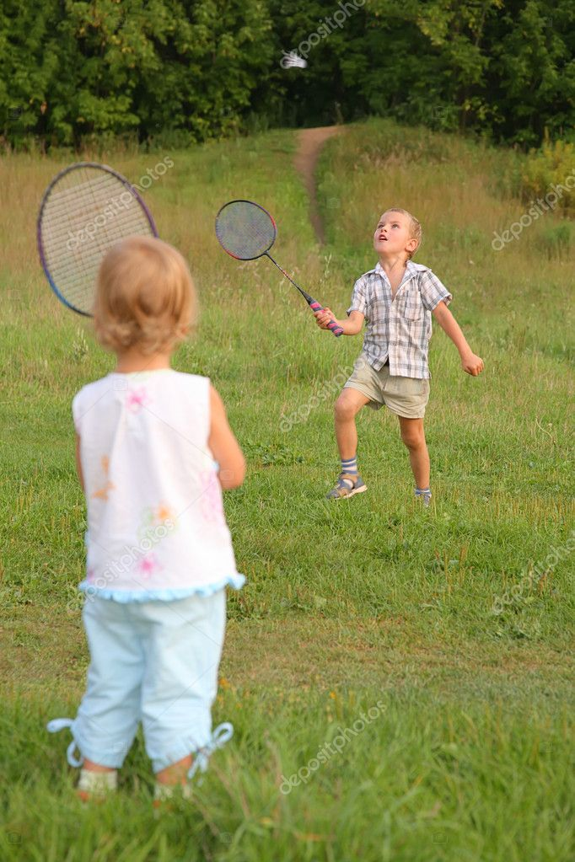
Capstone Project
Life Sports Total Solution
Team 11
Kong Chanhyung
Keum Kanghyun
Lee Donghyun

Slide 2
Contents
01 Planning Intent
02 Project Introduction
03 Expected Scenario
04 Conclusion
05 Developing Plan

Slide 3
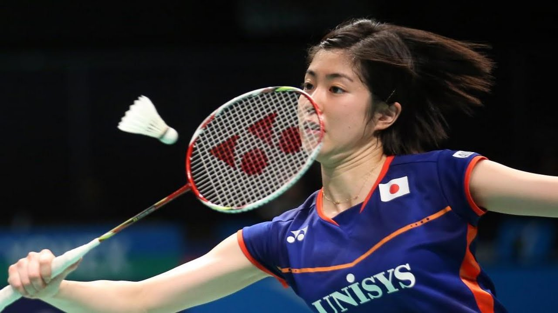
Planning
Intent
PART 1

Slide 4
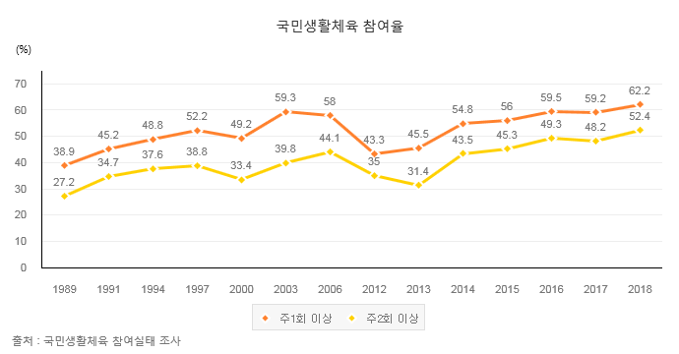
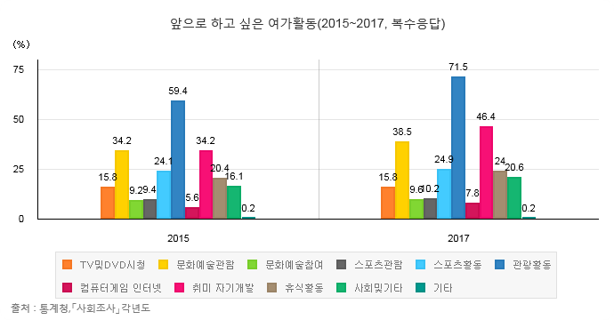
001
Planning Intent
Background
Trends in the participation rate of living sports
Participation rate of sports activities increased during leisure activities
Accessible method of participation is required

Slide 5
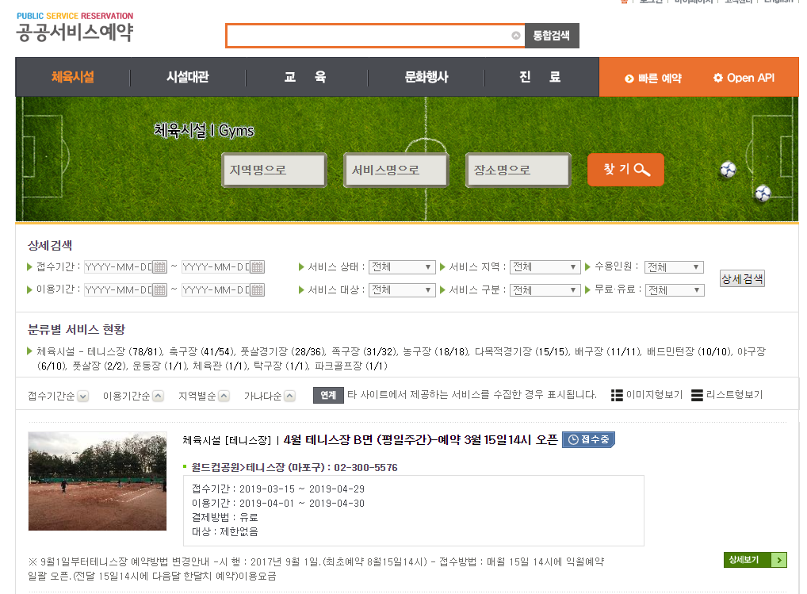
001
Planning Intent
Status Analysis(공공시설 예약포털)
Operated each city
Select place / item / time
Reservations are first-come-first-served basis

Slide 6
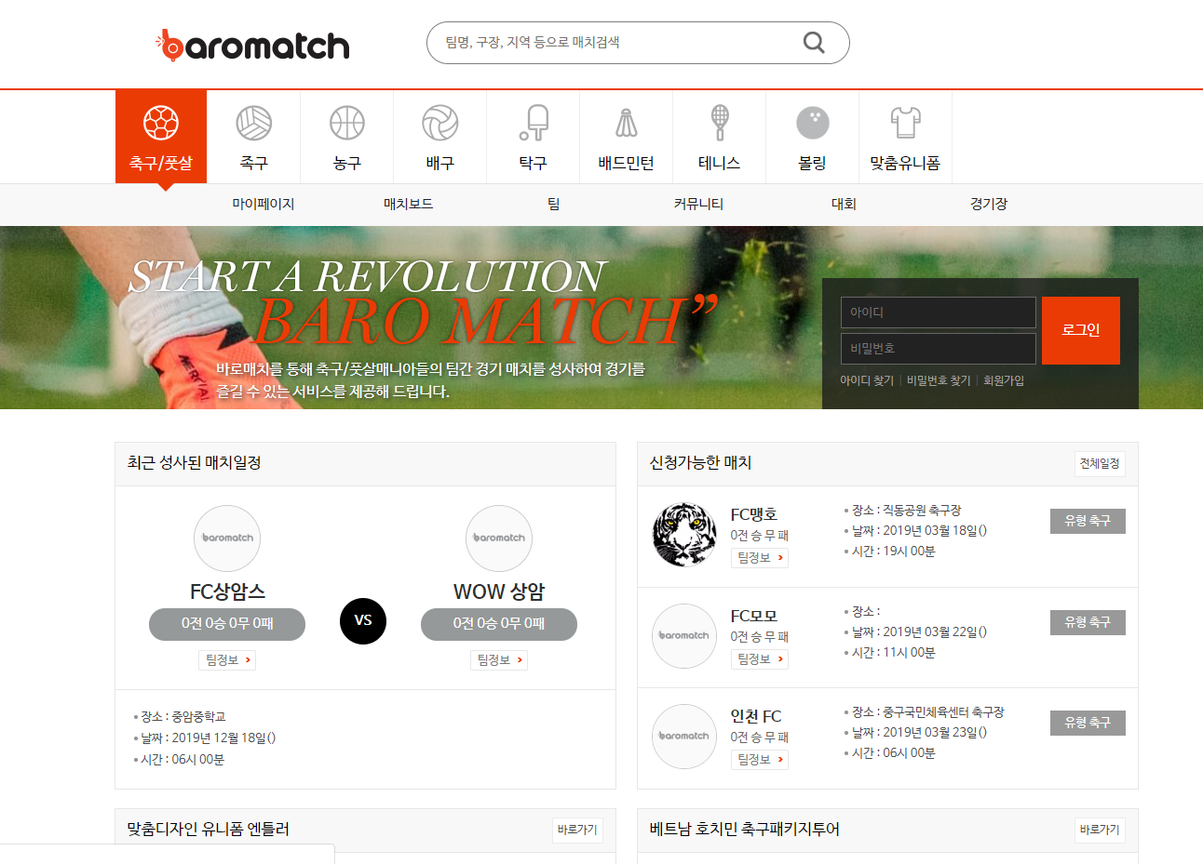
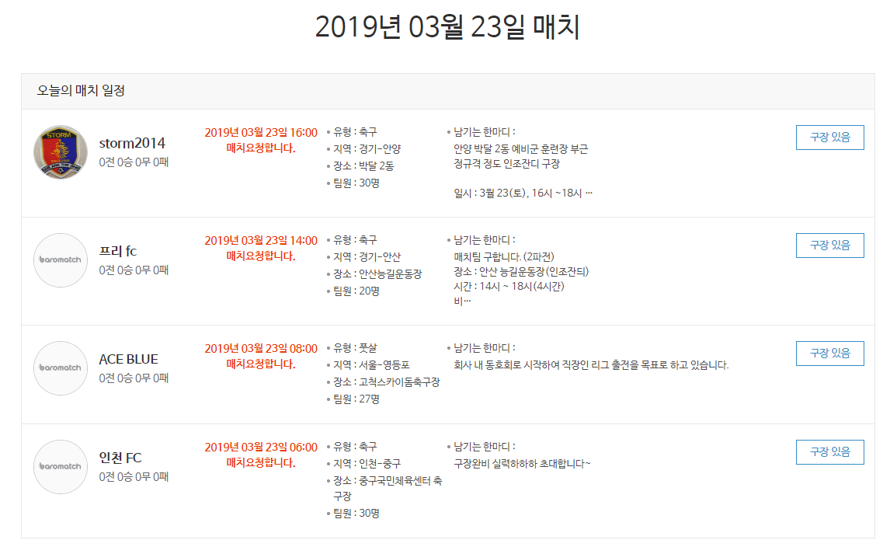
001
Planning Intent
Status Analysis(바로매치)
Team match only
Team management
Place rental in advance

Slide 7
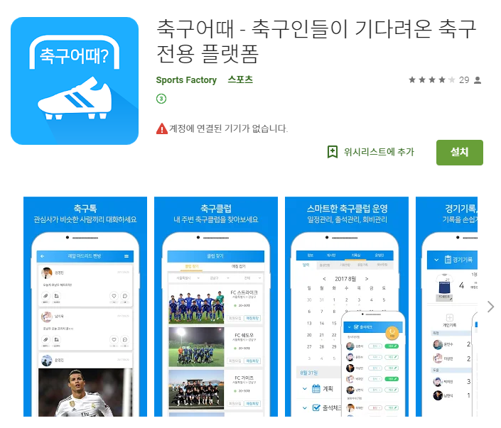
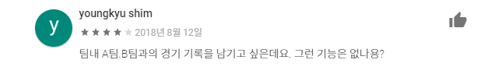
001
Planning Intent
Status Analysis(축구어때)
Team match only
Only for soccer
No Team management

Slide 8



001
Planning Intent
Problems with existing services
Reservation & Matching isn’t serviced at once
Inefficiency of facility operation
No individual units available
No Matching Balance Adjustment
Time consuming Process
Player
Facilities
Balance

Slide 9
001
Planning Intent
Our Solution
Combine 3 elements
Integration of place reservation method
Activation of individual unit participation
Balanced matching
Player
Facilities
Balance

Slide 10
001
Planning Intent
Additional Ideas
Use time other than regular reservation
Enable public matching
Manage all matching data based on Big Data platform
Balance matching through collected data

Slide 11
Project
Introduction
PART 2

Slide 12

002
Project Introduction
Introduction
Whenever You Want,
Can be done in
Just 1 Platform
Wherever You Want,
In Appropriate Balance
Even if you are one…

Slide 13
002
Project Introduction
Core Service
Regular Reservation
Public Matching
Ranking System

Slide 14
002
Project Introduction
Regular Reservation
Choose a time, place, and schedule for a specific time period
Two teams can make reservations and make a private match
One team can reserve and get a challenger
When team members are short, additional staff can be secured through recruitment announcement

Slide 15
002
Project Introduction
Public Matching
Use time other than regular reservations
Individuals can apply freely
Automatically organizes teams based on their previous matching data

Slide 16


002
Project Introduction
Ranking System
Of course, with matching data management
Used to adjust matching balance
Capable of occupying specific athletic facilities
Use in future automatic matching system
star7
2. ABC
3. Korea
4. S6
…
Team Name : star7
Team’s main subject : Soccer
Team Score : 145 / 157 (92%)
Recent Records :

Slide 17
002
Project Introduction
Objective
Solving existing service problems (3 factor connection)
Minimize preparation time
Maximizing life sports satisfaction with well-balanced match

Slide 18
Expected
Scenario
PART 3

Slide 19
003
Expected Scenario
User : Team
12
Team C checks the contents of the timetable and can challenge teams A and B
Or, Team A and B can make a private match
14
Team C
16
Team A
Team B

Slide 20
003
Expected Scenario
User : Individual
12
14
Freely choose the desired time
Entry into the open space.
When the number of people for the game is satisfied, a team is formed based on the score automatically.
16

Slide 21
PART 4
Conclusion

Slide 22
004
Conclusion
Differentiation from other services
Facility-person-balance integration
The game can be played as soon as possible
Individual users also have access to life sports
Support various sports integration
Ranking system raises competition awareness

Slide 23
004
Conclusion
Balance adjustment - use big data
Balance adjustment in public matching
Collect team / individual game data every game
Information collected: Contribution to the game by winning and losing, goals and goals, MVP ballot
May our data set not be ‘BIG’, but we would prepare future big data using Hadoop Environments.

Slide 24
004
Conclusion
Expected Results
Participation in life sports and satisfaction increase
Increase in activity rate of sports facilities
Coexistence of daily life and leisure activities

Slide 25
004
Conclusion
Vision
Positioned as a public booking service for many athletic facilities
User-level auto-matching system

Slide 26
Development
Plan
PART 5

Slide 27
005
Development Plan
3rd Week
Dates Task Descriptions | March |  |  |  | April |  |  |  |  | May |  |  |  | June
 | 4 | 11 | 18 | 25 | 1 | 8 | 15 | 22 | 29 | 6 | 13 | 20 | 27 | 3 | 10 | 17
Team Organization |  |  |  |  |  |  | Midterm Demonstration & Presentation |  |  |  |  |  |  | Final Demonstration & Presentation
Subject Confirmation / Write out the Proposal
Web UI Design
Web Structure Construction
Data gathering & Generation / Data modeling
Database Construction
App UI Design
App Structure Construction
Preparing for Mid-Demo
Functional Implementation : Regular Reservation
Functional Implementation : Non-regular Reservation
Functional Implementation : Ranking System
Test and Debugging
Preparing for Final Demo
Writing Manuals and Reports

Slide 28
Thank You!

Slide 29
001
Planning Intent
Template

